Slide 1
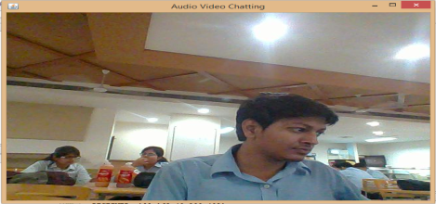
Wireless Chat Messenger
By Arpit Singhal (9913103432)
Jaypee Institute Of Information Technology
Introduction : The application provides the users a platform to chat via text, audio and video on a wireless connection.
Problem Statement : The chatting applications usually require internet connection for the session to start and there is a considerable lag in the transmission of audio and video feed over the network.
Result : This application uses wireless LAN technology to establish a connection for the chatting sessions between the clients. The users can experience a delay free chat session with negligible buffering of video or audio transmission.
Conclusion : The application wireless chat messenger can be used anywhere with no requirements of internet connection and it requires no hardware devices either except the PC’s of the user.

